Slide 1
Speed Skating Official Rules

Slide 2
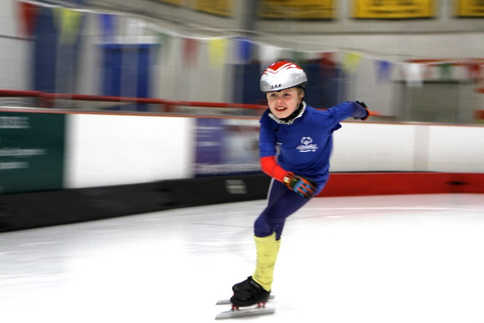
A picture paints a thousand words
“Let me win, but if I cannot win, let me be brave in the attempt.”
“Let me win, but if I cannot win, let me be brave in the attempt.”
Use the Picture and Caption format to create strong compelling slide like this. Don’t’t forget to caption where possible. For best effect crop the image to fill the placeholder.

Slide 3
The Basics
Sport season:
December – February
Culminating State Events:
State Winter Games

Slide 4
Events Offered
100-Meter
300-Meter
500-Meter
800-Meter
3000-Meter Unified Relay

Slide 5
Uniform Guidelines
All speed skaters will wear long-sleeved uniforms, knee pads, shin guards, and cut resistant throat protectors, cut resistant and no protrusions (which might get caught on a blade) gloves/mittens of a protective nature, and an approved safety helmet with a hard shell and chin strap.
All competitors must wear competition numbers for both time trial and final races.
Jewelry, and denim may not be worn during competition or practice. Headwear for religious or medical reasons are acceptable but must be brought to the attention of the Games Director.

Slide 6
Equipment
All helmets must be an ISU approved helmet and be free of protrusions
Skates:
Speed skaters should wear speed skates. In the event speed skates are not available to the athlete, hockey skates may be used. Figure skates and Klap style speed skate blades are not permitted.
Elbow pads are optional.
Competition equipment, such as skates, must pass all appropriate safety guidelines.

Slide 7
Rink Layout
The track shall be set on an ice rink with a minimum length of 56.38 m and a minimum width of 25.90 m.
This is the size of a typical hockey size ice rink.
If a 111-meter track is used the distance and laps are:
1 Lap = 111 M
3 Laps = 333 M
4.5 Laps = 500 M
7 Laps = 777 M

Slide 8
Rink Layout
Nothing shall be placed in or above the competitors' paths, or on or above the ice.
Safety mats must be present during all training and competition periods
Rink barriers/walls shall be covered by mats from the curve apex block to the centerline of the rink. The mats shall be of double thickness along the rink barrier on the far side of the curve. Mats shall be attached to the rink barrier with their weight on the ice. Mat height must be adequate to cover the height of the wall of the ice rink.

Slide 9
Rink Layout

Slide 10
General Rules
Athletes entered in Speed Skating at State Winter Games may not participate in any other sports.
Athletes may participate in up to two events within Speed Skating.
Athletes may enter the 3000M Unified Relay as a 3rd event.
There should be two skaters on the track at all times.
In a three-athlete division, all three athletes may compete at the same time.
Speed Skaters must go to the middle of the rink to stop. A skater who uses the wall to maintain balance or to assist in propelling oneself forward is considered assistance and will be disqualified.

Slide 11
Start Equipment
A start pistol or whistle shall be used to begin each race. False starts will require a restart.
For hearing impaired skaters, dropping a hand or flag shall accompany the sound of the gun.

Slide 12
Track Markers
Moveable markers of rubber or other suitable material shall be used to mark the track.
No track markers shall be of such size and width, or be fixed to the ice, so that they will not move freely if they are struck by a skater.

Slide 13
Race Start
All skaters shall start a race with both skates behind the start line.
A speed skater shall finish the race when the blade of one of his/her skates first crosses the finish line after completing the appropriate number of laps in the race.
If a skater is interfered with and falls before the first apex block after the starting line, the skaters may be called back to make a new start. This decision is up to the race referee.

Slide 14
Race Start
The starter shall position himself/herself in front of the start line in such a way that he/she is clearly visible and distinguishable as the starter to all skaters starting the race.
Races shall not start until the gun is fired or the whistle is blown. Skaters making two false starts shall be disqualified.

Slide 15
Start Command
To begin a race, the starter will:
Announce: "Go to the start" (Skaters step to start line and place skates behind the start line).
Starter should give the athletes ample time to settle down and assume a balanced position after taking their marks.
Announce: "Ready" (skaters get down into start position).
Signal the start of the race with the firing of a start pistol or blowing a whistle.

Slide 16
Unified Speed Skating Relay Rules
Each team shall consist of two Special Olympics Athletes and two Unified Partners.
Team members may race in any order.
Each team member must skate a minimum of three laps. The last two laps must be skated by a single skater that will be an Athlete member of the team.
Each team shall be clearly identified by wearing the same uniform or by wearing the same color pinnie, vest or helmet bib.
There should be no more than two relay teams on the ice at any time.

Slide 17
Unified Speed Skating Relay Rules
The relay zone will be between the hockey blue lines.
The relay exchange may be completed by either push start or tag of hand.
No other personnel, other than the referees, will be on the ice to allow the infield of the track to be used for marshaling and pacing for relay exchanges.

Slide 18
Disqualifications
When overtaking, the responsibility for any obstruction or collision shall be upon the skater overtaking, provided that the skater being overtaken does not act improperly.
A skater on the outside of the track shall be deemed to be the skater overtaking if the skaters are side-by-side entering the first curve.
A skater shall not deliberately impede or push another skater with any part of his/her body, thereby gaining an advantage.
Any skater who willfully impedes, improperly crosses the course or, in any way interferes with another skater, or conspires with others to cause a race to result otherwise than on its merit, shall be disqualified.

Slide 19
Disqualifications
Any skater, who unnecessarily slows down, thereby causing another skater to slow or collide, shall be disqualified.
A skater who permits himself/herself to receive physical assistance during a race that is not a relay shall be disqualified.
A skater who uses the wall to maintain balance or to assist in propelling oneself forward is considered assistance and shall be disqualified.
A skater shall be disqualified for intentionally moving the corner track markers or failing to skate at all times outside the corner track markers.

Slide 20
Disqualifications
The Referee may disqualify a skater from a race if the skater deliberately kicks out a skate or throws his/her body across the finish line thereby endangering another skater at the finish line.
A disqualification must be announced at the end of each heat to the skater, team leader, or coach and over the public address system for the benefit of the spectators.

